Slide 1
Money Matters : A personal Finance Management App Using Kotlin
Submitted by:
S.Akash
A.Gunavathy
V.Harinath
A.Irfan Ahamed

Slide 2
Description
Money Matters is a sleek personal finance management app developed using Kotlin, designed to simplify and optimize your financial life. It offers features like expense tracking, budget planning, income management, and savings goal setting, empowering users to monitor and control their finances effectively. With detailed reports, analytics, and visualizations, users gain insights into spending habits and financial health. The app includes bill reminders, customizable interfaces, and secure data encryption to ensure privacy and usability. Seamless cloud sync and backup provide access across devices, while Kotlin ensures a smooth and responsive experience. Money Matters makes financial management effortless and stress-free!

Slide 3
Required Dependencies
User Interface (UI) with Jetpack Compose: Utilize Jetpack Compose for building a modern, responsive, and declarative UI. It simplifies UI design, especially for handling complex screens like budgeting, transaction tracking, and financial reports.
Data Storage with Room Database: Use Room for local database management, enabling efficient and secure storage of user financial data, including transactions, budgets, and savings goals.
Networking with Retrofit & Coroutines: Integrate Retrofit for making API calls to fetch data (e.g., exchange rates, stock prices, etc.), and use Kotlin Coroutines for asynchronous operations, ensuring smooth user interactions.
Analytics and Security: Implement Firebase Analytics for tracking user behavior and improving app experience, while ensuring robust data security and user privacy, especially for sensitive financial information.

Slide 4
coding
package com.example.expensestracker
import android.annotation.SuppressLint
import android.content.Context
import android.content.Intent
import android.os.Bundle
import android.widget.Toast
import androidx.activity.ComponentActivity
import androidx.activity.compose.setContent
import androidx.compose.foundation.layout.*
import androidx.compose.material.*
import androidx.compose.runtime.*
import androidx.compose.ui.Alignment
import androidx.compose.ui.Modifier
import androidx.compose.ui.graphics.Color
import androidx.compose.ui.platform.LocalContext
import androidx.compose.ui.text.font.FontWeight
import androidx.compose.ui.text.style.TextAlign
import androidx.compose.ui.unit.dp
import androidx.compose.ui.unit.sp

Slide 5
class AddExpensesActivity : ComponentActivity() {
private lateinit var itemsDatabaseHelper: ItemsDatabaseHelper
private lateinit var expenseDatabaseHelper: ExpenseDatabaseHelper
@SuppressLint("UnusedMaterialScaffoldPaddingParameter")
override fun onCreate(savedInstanceState: Bundle?) {
super.onCreate(savedInstanceState)
itemsDatabaseHelper = ItemsDatabaseHelper(this)
expenseDatabaseHelper = ExpenseDatabaseHelper(this)
setContent {
Scaffold(
// in scaffold we are specifying top bar.
bottomBar = {
// inside top bar we are specifying
// background color.
BottomAppBar(backgroundColor = Color(0xFFadbef4),
modifier = Modifier.height(80.dp),
// along with that we are specifying
// title for our top bar.
content = {
Spacer(modifier = Modifier.width(15.dp))
Button(
onClick = {startActivity(Intent(applicationContext,AddExpensesActivity::class.java))},
colors = ButtonDefaults.buttonColors(backgroundColor = Color.White),
modifier = Modifier.size(height = 55.dp, width = 110.dp)
)

Slide 6
{
Text(
text = "Add Expenses", color = Color.Black, fontSize = 14.sp,
textAlign = TextAlign.Center
)
}
Spacer(modifier = Modifier.width(15.dp))
Button(
onClick = {
startActivity(
Intent(
applicationContext,
SetLimitActivity::class.java
)
)
},
colors = ButtonDefaults.buttonColors(backgroundColor = Color.White),
modifier = Modifier.size(height = 55.dp, width = 110.dp)
)
{
Text(
text = "Set Limit", color = Color.Black, fontSize = 14.sp,

Slide 7
textAlign = TextAlign.Center
)
}
Spacer(modifier = Modifier.width
Button(
onClick = {
startActivity(
Intent(
applicationContext,
ViewRecordsActivity::class.java
)
)
},
colors = ButtonDefaults.buttonColors(backgroundColor = Color.White),
modifier = Modifier.size(height = 55.dp, width = 110.dp)
)
{
Text(
text = "View Records", color = Color.Black, fontSize = 14.sp,
textAlign = TextAlign.Center
)
}

Slide 8
AddExpenses(this, itemsDatabaseHelper, expenseDatabaseHelper)
}
}
}
}
@SuppressLint("Range")
@Composable
fun AddExpenses(context: Context, itemsDatabaseHelper: ItemsDatabaseHelper, expenseDatabaseHelper: ExpenseDatabaseHelper) {
Column(
modifier = Modifier
.padding(top = 100.dp, start = 30.dp)
.fillMaxHeight()
.fillMaxWidth(),
horizontalAlignment = Alignment.Start
) {
val mContext = LocalContext.current
var items by remember { mutableStateOf("") }
var quantity by remember { mutableStateOf("") }
var cost by remember { mutableStateOf("") }
var error by remember { mutableStateOf("") }
Text(text = "Item Name", fontWeight = FontWeight.Bold, fontSize = 20.sp)
Spacer(modifier = Modifier.height(10.dp))
TextField(value = items, onValueChange = { items = it },

Slide 9
label = { Text(text = "Item Name") })
Spacer(modifier = Modifier.height(20.dp))
Text(text = "Quantity of item", fontWeight = FontWeight.Bold, fontSize = 20.sp)
Spacer(modifier = Modifier.height(10.dp))
TextField(value = quantity, onValueChange = { quantity = it },
label = { Text(text = "Quantity") })
Spacer(modifier = Modifier.height(20.dp))
Text(text = "Cost of the item", fontWeight = FontWeight.Bold, fontSize = 20.sp)
Spacer(modifier = Modifier.height(10.dp))
TextField(value = cost, onValueChange = { cost = it },
label = { Text(text = "Cost") })
Spacer(modifier = Modifier.height(20.dp))
if (error.isNotEmpty()) {
Text(
text = error,
color = MaterialTheme.colors.error,
modifier = Modifier.padding(vertical = 16.dp)
)
}
Button(onClick = {
if (items.isNotEmpty() && quantity.isNotEmpty() && cost.isNotEmpty()) {
val items = Items(
id = null,
itemName = items,
quantity = quantity,
cost = cost

Slide 10
label = { Text(text = "Item Name") })
Spacer(modifier = Modifier.height(20.dp))
Text(text = "Quantity of item", fontWeight = FontWeight.Bold, fontSize = 20.sp)
Spacer(modifier = Modifier.height(10.dp))
TextField(value = quantity, onValueChange = { quantity = it },
label = { Text(text = "Quantity") })
Spacer(modifier = Modifier.height(20.dp))
Text(text = "Cost of the item", fontWeight = FontWeight.Bold, fontSize = 20.sp)
Spacer(modifier = Modifier.height(10.dp))
TextField(value = cost, onValueChange = { cost = it },
label = { Text(text = "Cost") })
Spacer(modifier = Modifier.height(20.dp))
if (error.isNotEmpty()) {
Text(
text = error,
color = MaterialTheme.colors.error,

Slide 11
modifier = Modifier.padding(vertical = 16.dp)
)
Button(onClick = {
if (items.isNotEmpty() && quantity.isNotEmpty() && cost.isNotEmpty()) {
val items = Items(
id = null,
itemName = items,
quantity = quantity,
cost = cost
)dval limit= expenseDatabaseHelper.getExpenseAmount(1)
val actualvalue = limit?.minus(cost.toInt())
// Toast.makeText(mContext, actualvalue.toString(), Toast.LENGTH_SHORT).show(
val expense = Expense(
id = 1,
amount = actualvalue.toString()
)
if (actualvalue != null) {
if (actualvalue < 1) {
Toast.makeText(mContext, "Limit Over", Toast.LENGTH_SHORT).show()
} else {
expenseDatabaseHelper.updateExpense(expense)
itemsDatabaseHelper.insertItems(items)
}
}
}
}) {
Text(text = "Submit")
}
}
}

Slide 12
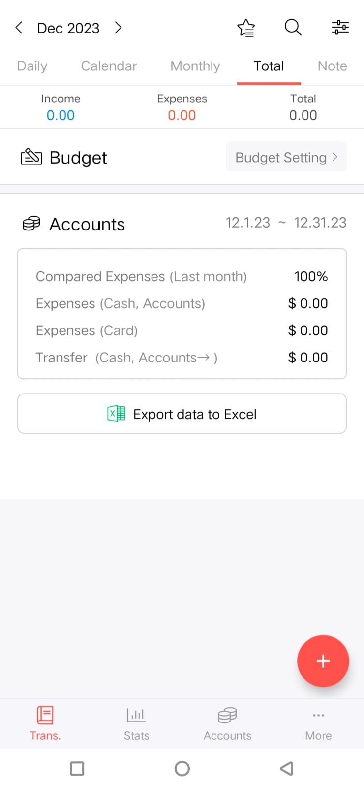
Output:

Slide 13
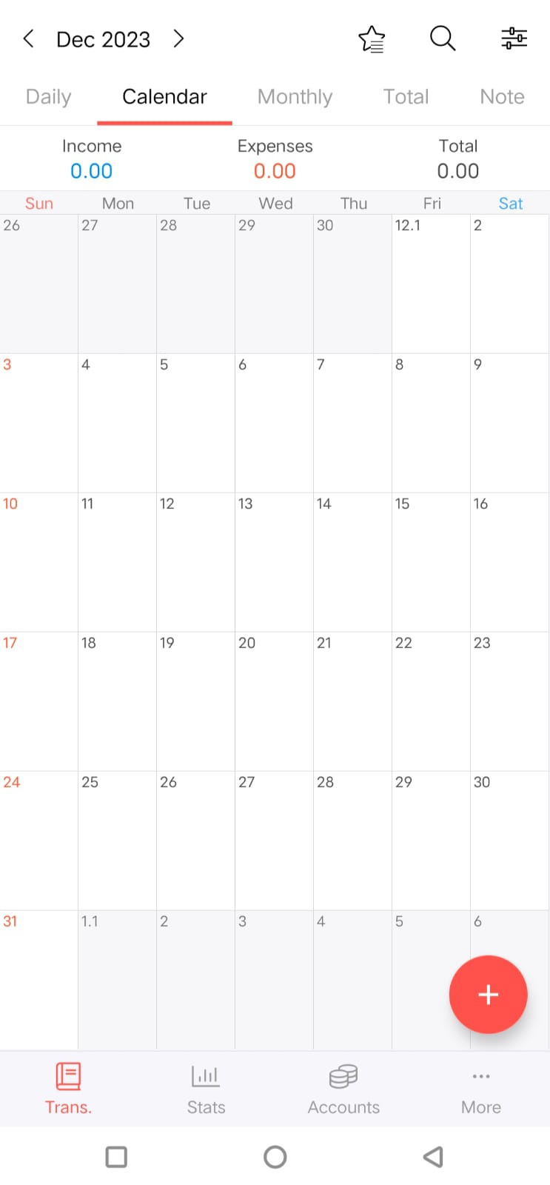

Slide 14
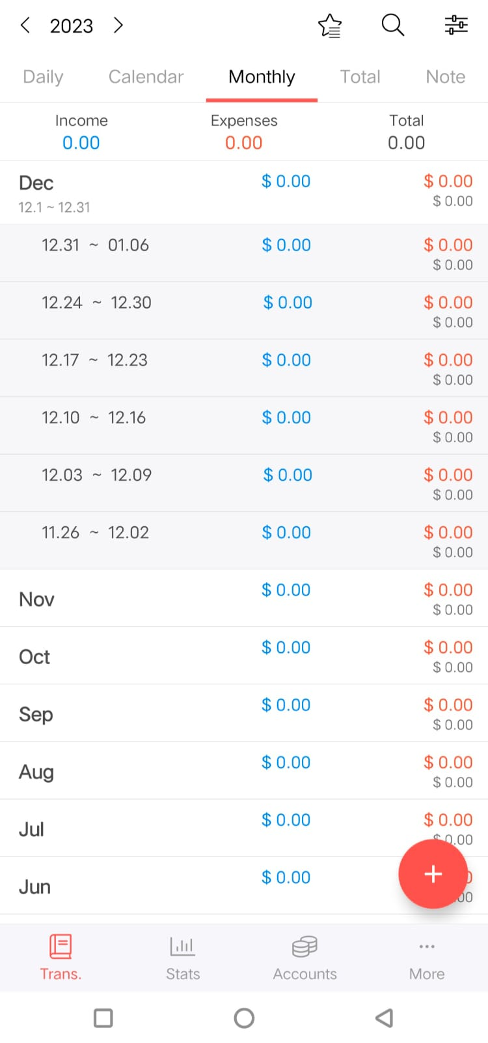

Slide 15
